Slide 1
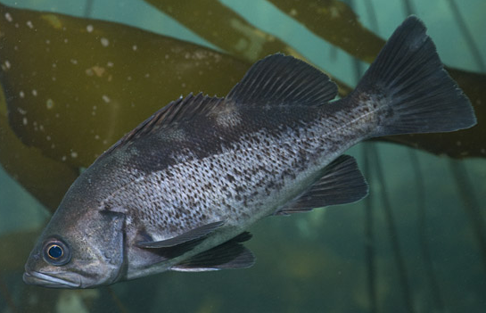
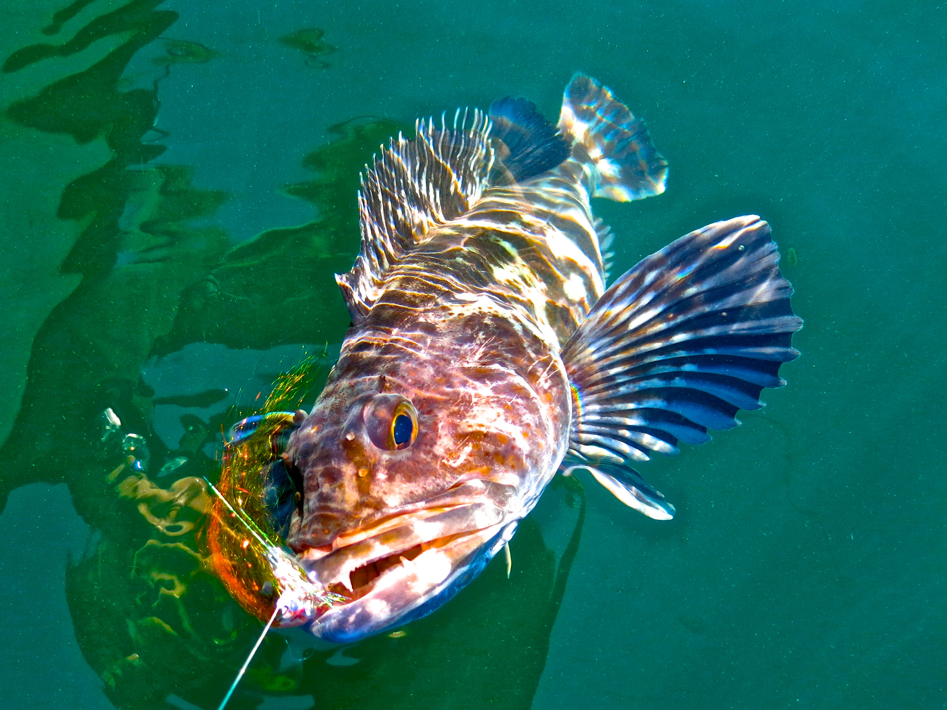
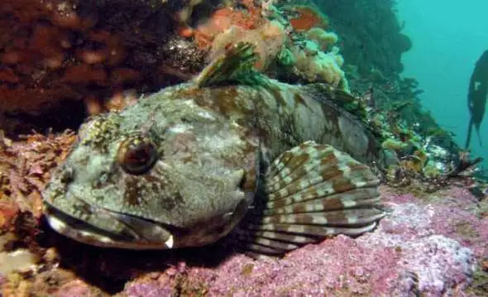
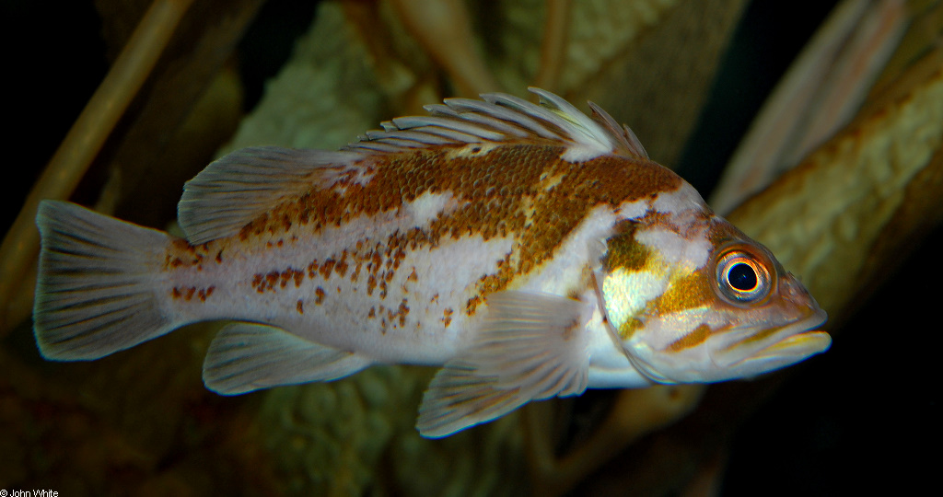
Implications of Transient Dynamics and Stochasticity for Adaptive Management of Marine Reserves
Victoria Quennessen
MS Student in Fisheries Science
IB 599: Analytical Workflows
Initial Presentation
April 10th, 2019
Levi
Jay Nichols
FishWithJD
John White

Slide 2
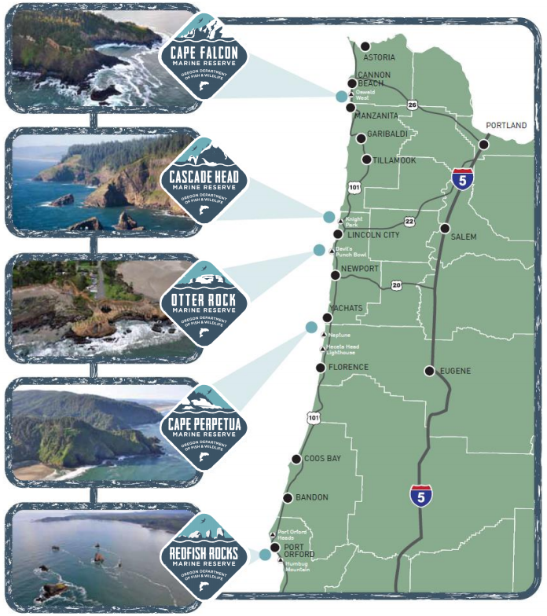
Introduction - Oregon
Background
Methods
Hypotheses and Outcomes
ODFW has implemented 5 marine reserves off the coast of OR in last 10 years
Need some way to assess reserves
Promote biodiversity (ergo population persistence)
Minimize costs to communities

Slide 3
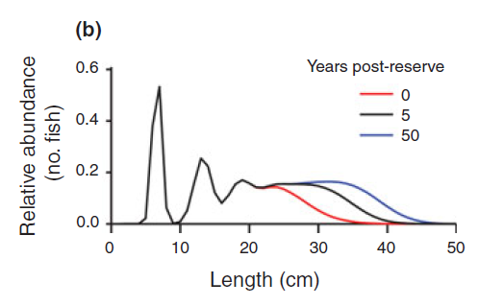
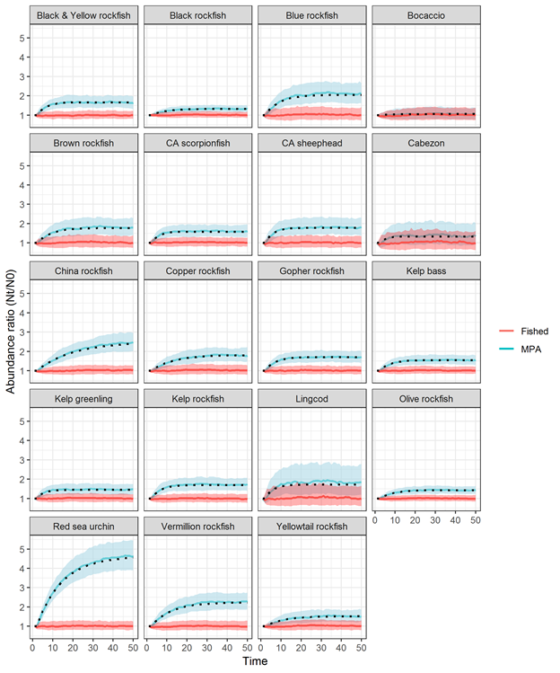
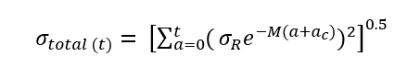
Transient Dynamics and Stochasticity
Background
Methods
Hypotheses and Outcomes
Abundance Ratio (N_{t}/N₀)
Fished
MPA
Time (years)
Adapted from Kaplan et al., in review
White et al., 2013
Notes:
Transient dynamics = short-term dynamics, not same as long-term dynamics
Blue line = unfished population size distribution
Red line = current population size distribution
Key findings state that the eventual increase in abundance and biomass inside reserves depends on the level of fishing in that area prior to reserve implementation,
Open population dynamics with stochastic recruitment
The rate at which the age structure fills in and biomass increases depends on the species’ natural mortality rate, von Bertalanffy growth rate, variability in recruitment, and the age at entry into the fishery (Kaplan et al. in review; White et al. 2013).

Slide 4
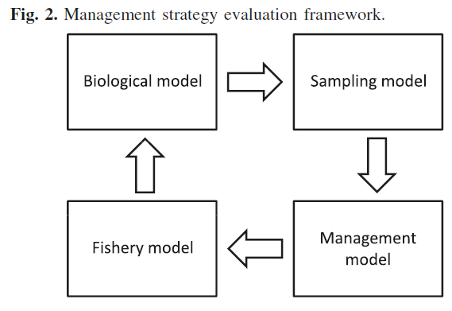
Base Model and Control Rules
Background
Methods
Hypotheses and Outcomes
Density ratio as metric to assess level of depletion:
# ind./ area outside reserve
-------------------------------------
# ind./ area inside reserve
Current west coast groundfish fishery has 40-10 control rule
Babcock & MacCall 2011

Slide 5
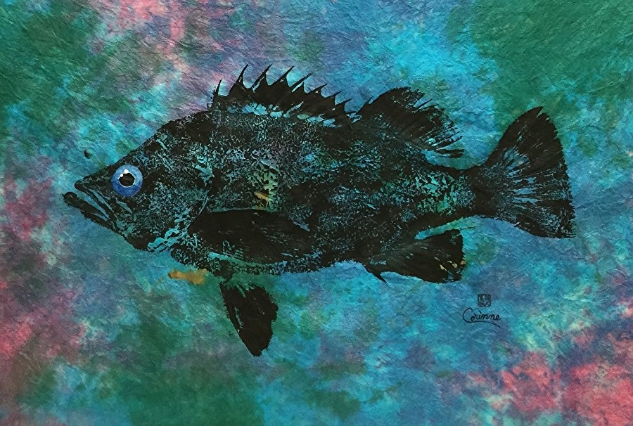

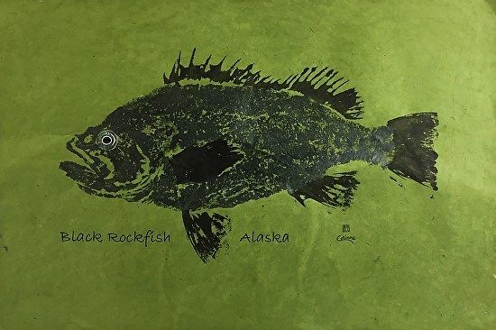
Methods - Chapter 1
Background
Methods
Hypotheses and Outcomes
Replicate base model
Incorporate variability and stochastic recruitment
Explore timescales
Compare control rules

Slide 6
Hypotheses and Outcomes
Background
Methods
Hypotheses and Outcomes
Hypotheses
Different species will have different timescales
Improved adaptive management
Outcomes
Improved methodologies for assessment and management of fisheries populations in marine reserves following implementation
Open-access base model in R
Lowest M
Highest k
Notes:
Lower mortality (M) + higher growth rates (k) = shorter timescales

